Slide 1
Amazon Prime Titles:
Data Analysis
Muhammad Attila An Naufal
28th July, 2023
- Revou Data Analysis Mini Course Case Study -

Slide 2

Outline
Introduction
Methodology
Results
Discussion
Conclusion
Appendix

Slide 3

Introduction
Amazon Prime is one of the most popular media and video streaming platforms. They have close to 10000 shows available on their platform, as of mid-2021, they have over 200M Subscribers globally.
Dataset used is a listings of all the movies and tv shows available on Amazon Prime, along with details such as - cast, directors, ratings, release year, duration, etc.
Using the dataset, we can find these points/trends :
Distribution of shows over time
Common categories of shows
Composition of shows type

Slide 4

Methodology
Data Wrangling
Exploratory Data Analysis
Jupyter Notebook
Python (Pandas)
Data Visualization
Python (Matplotlib & Seaborn)
Google Sheets

Slide 5

Results

Slide 6
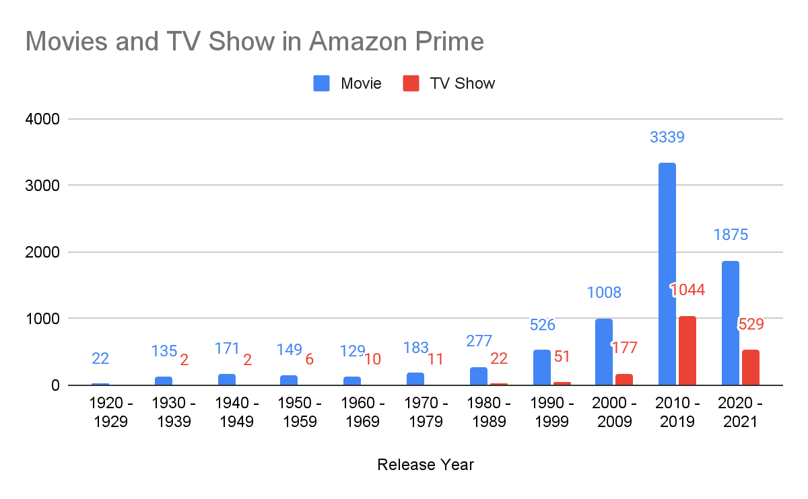
The chart proposes that most of the Amazon Prime content was released in 2010 - 2019 and that the number of Movie always outnumbered TV Show.

Slide 7
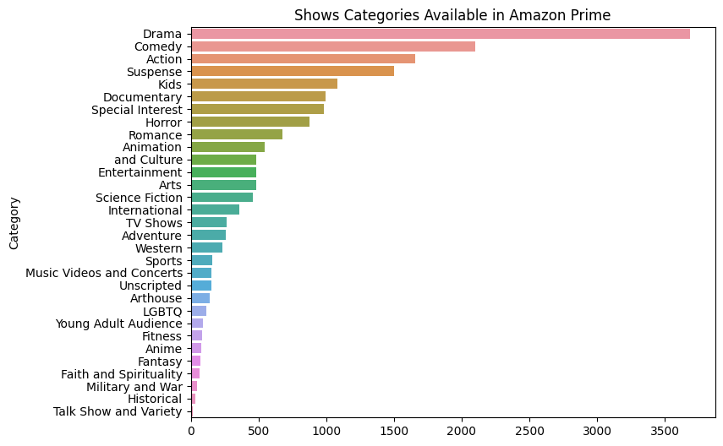
According to this data, it seems that Drama is the most common category, whereas Talk Show and Variety is the least common category on Amazon Prime.

Slide 8
Overall Findings
Movie dominate 80% of Amazon Prime content
More than half of the content on Amazon Prime is released in 2010 - 2021
Drama is the most common category on Amazon Prime followed by Comedy and Action
The least common category on Amazon Prime is Talk Show and Variety

Slide 9
Conclusion
Through analyzing the Amazon Prime Titles dataset, we can extract insight regarding the distribution and categories of the shows on the Amazon Prime.
These insights can benefit online streaming consumer as well as Amazon Prime content curation team.

Slide 10

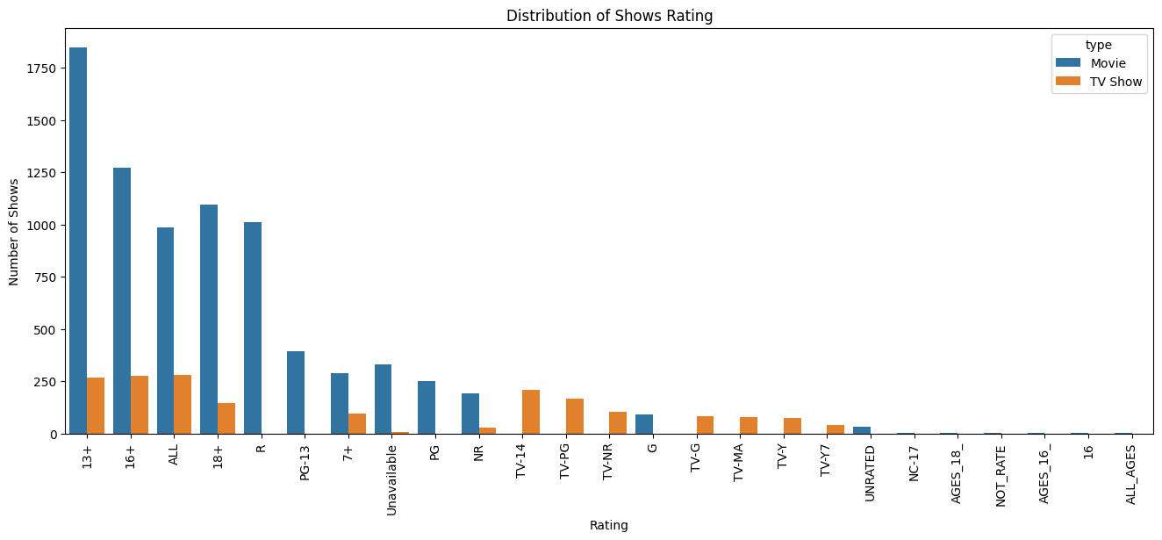
Appendix

Slide 11
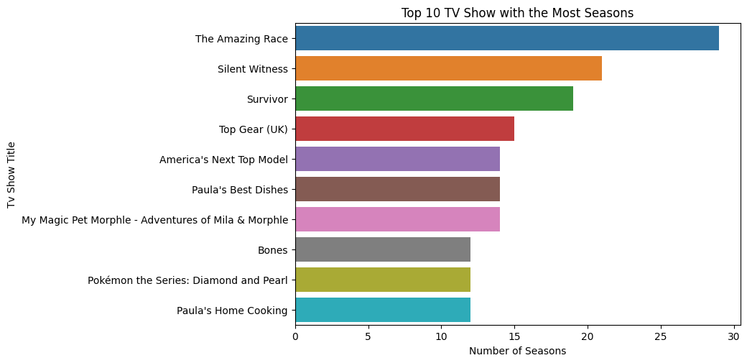
Appendix

Slide 12
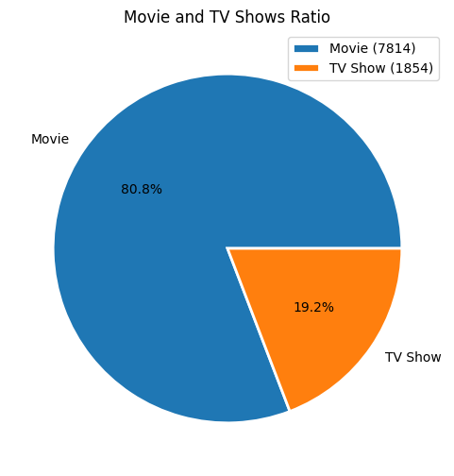
Appendix

Slide 13
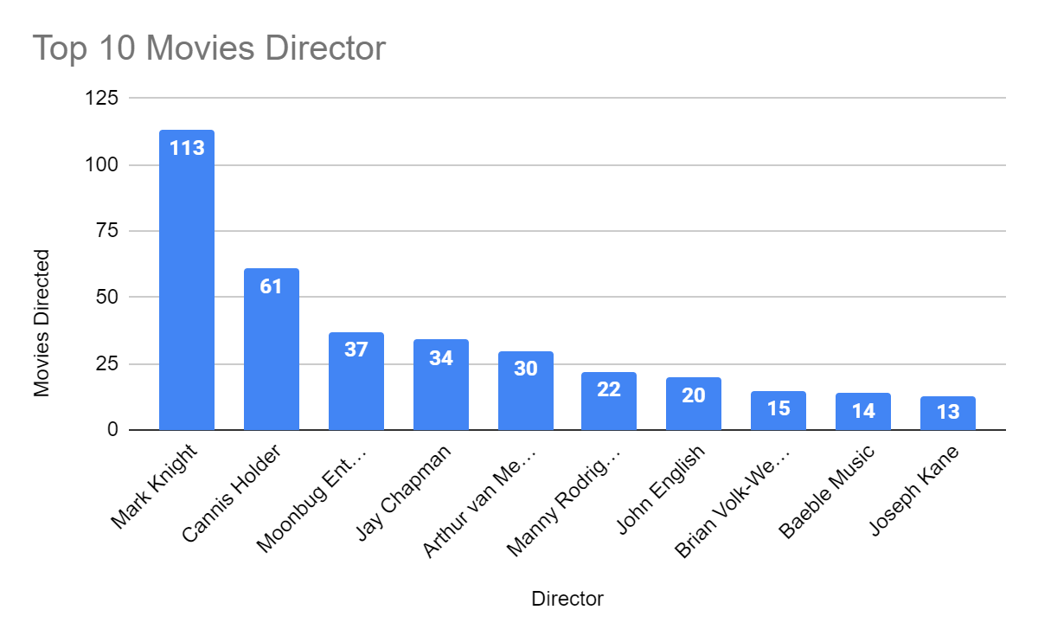
Appendix

Slide 14
Appendix
Notebook :
https://www.kaggle.com/code/mattnaufal/amazon-prime-titles-exploratory-data-analysis
Google Sheets :
https://docs.google.com/spreadsheets/d/1GRZT1PvETeLCgOLG3J-n17okXCbl5W98P5wGPcBAFCg/edit?usp=sharing

Slide 15


Thank You!
Find me at:

